Slide 1
Peer feedback
Civil engineering education

Slide 2
Nordplus project year 2018 - 2019 Student peer review at Nordic Universities
Partner institutions:
Roskilde University, University of Jyväskylä, University of Gothenburg, University of Southern Denmark, University College Copenhagen and University of Copenhagen
Aim of project:
The participating teachers wish to jointly develop formative practices centered on peer review feedback methods in university teaching in the Nordic countries to improve teaching efficiency and students’ engagement with the curriculum.
Our emphasis will be on sharing best practice on uses and implementations of peer review practices in university courses and on assessing the strengths and potentials of different applications.
Product:
We analyzed these different examples in courses where we already used peer review and discussed key questions to consider in developing peer review practices in Higher Education teaching.
Paper with the 14 questions in a template prompt and 6 example
Notes:
Research suggests that for students to learn from feedback, it is important that they engage with it – by asking questions, discussing the feedback, and constructing their own meaning from it (Black et al. 2004; Ellegaard et al. 2018; Doyle, Buckley, and Whelan 2019).
Peer review can be seen as both a method for increasing feedback without overburdening teachers and as an effective means of teaching in itself.
All the participants use various forms of student-to-student peer review as tools in their teaching.

Slide 3
Nordplus project year 2018 - 2019 Student peer review at Nordic Universities
The teachers understanding of Feedback
The essence is: feedback has to give information back and be used otherwise it isn´t feedback!
The key questions fall within four main headings:
Contextual Framework for the peer review practice
Purpose and aims development
Use of assessment Criteria
Embedding and support of the initiatives into the teaching and learning activities
Notes:
Handout

Slide 4
Peergrade Example
Framework: Interdisciplinary course with a theme project at 1st semester bachelor program for civil engineers with aprox. 80 students. The theme is land development in urban areas. The students work on the project in randomized groups of 6-7.
Purpose: It provides specific formative feedback on every group’s drawings, which is not possible for the teacher due to the large class size. It prepares students for the workflow in their future profession.
Criteria: A good example of a drawing and a check list written on class with input from the students.
Support and embedding: Upload of a technical plan into Peergrade. The students are giving feedback in a rubric and are asked to comment/reflect on the feedback.
Notes:
Handout

Slide 5
An outline of the course
Exam
Introduction to the course
Topic 1
Topic 5.2
Topic 5.4
Projekt
Topic 8
Lectures
Topic 5.1
Topic 5.3
Topic 3
Toplic 7
Topic 2
Topic 4
Topic 6
Uge: 36 37 38 39 40 41 42 43 44 45 46 47 48 49 50 51
Hand in
Presentation of the solution to topic 3
Presentation of the solution to topic 5. Hand a presentation in at Peergrade
Hand in the project
Hand in the project after implementing the feedback
Introduction to the plan
Give oral feedback on the work of a peer group
Assessment
Use Peergrade to give feedback to a peer group
Use Peergrade to give feedback to an other group
Create a Rubric and try to use it on an old assignment
Notes:
What did I think:
It is easy to distribute the material to the students for them to give feedback on
I think that I got better reports in the end
As the course is on 5th semester the students are already used to giving feedback and so the introduction to that part can be toned down
When implementing a project and only making the students work with peer feedback on that part of the material in the course the other topics tend to be neglected by some students
At the exam mote that one student was unhappy to pic a topic that was not included in the project
Whar did the students say:
10 out of 12 groups handed in the project even though the project was voluntarily.
The students liked the possibility to work with the topics and get more feedback
The students felt more comfortabl with the topics included in the project at the exam but may bee this was on behalf of the topics not included
The students learn from tell others what they did. Should it only be the ones who have done the assignment that becomes a part of the peer feedback?
Rubrics was not used that much – We can do it our self
Peergrade:
Knowing the receiver of the feedback helped keeping a proper tone
They liked the written feedback but wanted to give oral feedback in addition to the written part

Slide 6
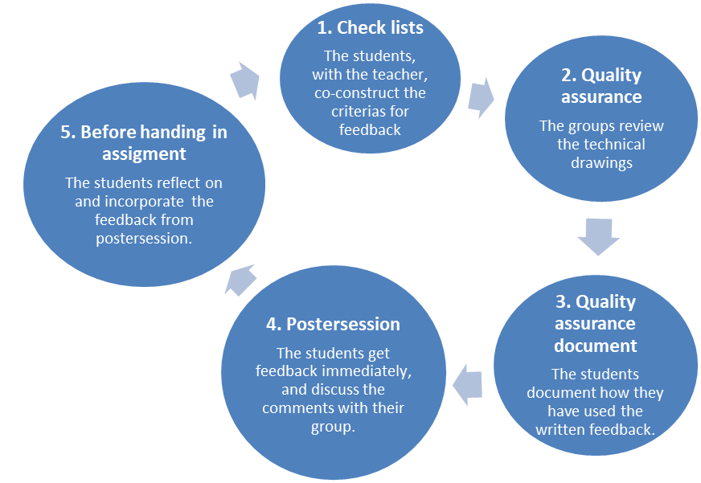
Postersession with plans of drainage system

Slide 7
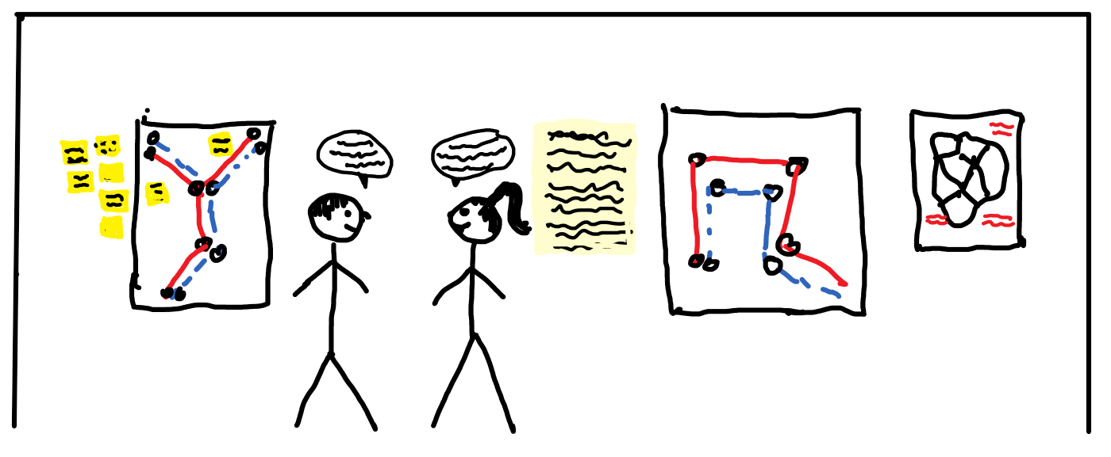
Feedback is given:
Orally
On post its
Written directly on the plan
On a paper on the wall next to the plan

